Slide 1
Prediction Models and Risk Score Generation in Clinical Research: An Introduction
OSCTR BERD WORKSHOP
October 29th , 2021
Tabitha Garwe, PhD, MPH
Associate Director – OSCTR BERD
Associate Professor of Epidemiology
Director, Surgical Outcomes Research
Co-Director – BERD Clinical Epidemiology Unit

Slide 2
Seminar Outline
Theoretical Background
  Model development
  Model Performance
  Internal Validation
  External Validation
Applied example using logistic regression

Slide 3
Major Types of Clinical Epidemiologic Studies
Clinical Practice : Challenges
PREDICTION RESEARCH
CAUSAL RESEARCH
DIAGNOSTIC RESEARCH
PROGNOSTIC RESEARCH
INTERVENTION
RESEARCH
ETIOLOGIC RESEARCH

Slide 4
Diagnostic and Prognostic Research
Diagnostic Research Objectives
  Individual test accuracy
  ID combination(s) of tests that have the largest diagnostic yield
  Does new test provides additional diagnostic value in clinical practice?
  Is a less burdensome/inexpensive test an alternative?
Prognostic Research Objectives
  which combination of determinants under study best predicts a future outcome?
  additional predictive value beyond other available predictors.
  may include comparison of the predictive accuracy of two (new) markers.

Slide 5
Prediction Models
Diagnostic process and prognostication - multivariable in nature
Require studies that follow a multivariable approach in design and analysis
Prediction models designed to assist healthcare professionals and patients make informed decisions
  use clinical and non-clinical patient characteristics to estimate the probability that a certain outcome is present (diagnostic) or will occur within a defined time period (prognostic)
  not a substitute for clinical experience

Slide 6
Prognostic Score Example
APACHE II Calculator
http://clincalc.com/IcuMortality/APACHEII.aspx

Slide 7
Smartphone App Example
Gonzalez et al., 2015, J Trauma Acute Care Surg Volume 78, Number 5

Slide 8
Model Objective and Study Design
Is a new model needed?
Diagnostic Studies: Cross-sectional, consecutive patients suspected of having a particular outcome
Prognostic studies: Cohort (preferably prospective), consecutive patients at risk of the outcome; also Case-cohort
Data Source Identification - Data should be representative of the target population for which a model is to be developed
  Prediction models best developed using prospectively collected data

Slide 9
Sample Size Considerations
Generally based on “events-per-variable” rule of thumb
  At least 10 outcome events required per candidate predictor parameter estimated
Traditional sample size calculation for regression analysis
  I prefer the PASS Sample Size software
Refined criteria for determining the sample sizes for model development have recently been proposed (Riley et al., 2020)
  ‘pmsampsize’ package for Stata and R.
Riley RD, Ensor J, Snell KIE, et al. Calculating the sample size required for developing a clinical prediction model. BMJ. 2020;368:m441. https://doi.org/10.1136/bmj.m441

Slide 10
Outcome
  Important, easily available, clearly defined and have minimal measurement error.
  Typically dichotomous but may comprise continuous variables such as tumor growth, pain, or quality of life, etc.
  Generally should not study intermediate outcomes
  Time period of outcome occurrence important
    Prediction over a shorter period is commonly less problematic than prediction over a longer time period.
    Follow-up time may differ- use Kaplan Meier or Cox regression
  Blinding important

Slide 11
Predictors
Predictors should preferably be measured using methods applicable-or potentially applicable-to daily practice
Feasibility plays an important role in choosing determinants
  study proxy or surrogate predictors if the underlying predictor is too cumbersome to measure
Potential predictors should be measured and analyzed with a view to chronological hierarchy in practice

Slide 12
Missing Data
Complete case analysis can substantially reduce the data available and may introduce bias
  Data may not be missing at random
One can consider excluding predictors missing in a sizable proportion of the data
Multiple imputation is the preferred approach for handling missing data

Slide 13
Model Fitting and Predictor Selection
Multivariable techniques
  Logistic regression – dichotomous outcome
  Cox regression – time to event data
  Linear regression – continuous outcomes
  Penalized regression (ridge, lasso)
  Machine learning techniques (tree based, neural networks)
Predictor Selection
  Any information that precedes the outcome of interest in time and potentially predictive of outcome
    demographic variables, clinical history, physical examination findings, type and severity of disease, comorbid conditions, and laboratory or imaging results.
    Events per variable (EPV) rule of thumb - at least 10 individuals with outcome event per predictor

Slide 14
Predictor Selection Strategies
Subject matter/ clinically-driven
  clinical experts in the research group or by literature review
Data-driven
  Univariate analysis (discouraged)
  multivariable modeling using forward selection (highly discouraged) or backward elimination
  Penalized regression (ridge, lasso) – limit overfitting
  All predictors initially included and selection occurs during the machine-learning based model development phase (tree-based, random forests, etc.)
Reducing number of candidate variables
  combining similar predictors to a single one
  exclude predictors that are highly correlated with others
  Exclude frequently missing or predictors with limited variability among the study population

Slide 15
Model Assumptions and Predictions
A model that satisfies its underlying assumptions will yield better predictions
Evaluate predictions in new data
Example – simple logistic regression
  2-week mortality ~ a + b1(ISS) + b2(PEC)
    Distribution of 2-week mortality is binomial
    ISS has a linear effect
    Effects of PEC and ISS can be added

Slide 16
Continuous Predictors and Interactions
Categorizing continuous variables into intervals
  adding multiple categories spends more degrees of freedom
  can lead to overfitting of the model
  consider non-linear relationships with the outcome (e.g. using restricted cubic splines or fractional polynomials)
Effect of one predictor on the outcome may be dependent on the value of another predictor
  Important interactions may be prespecified apriori and considered in model development

Slide 17
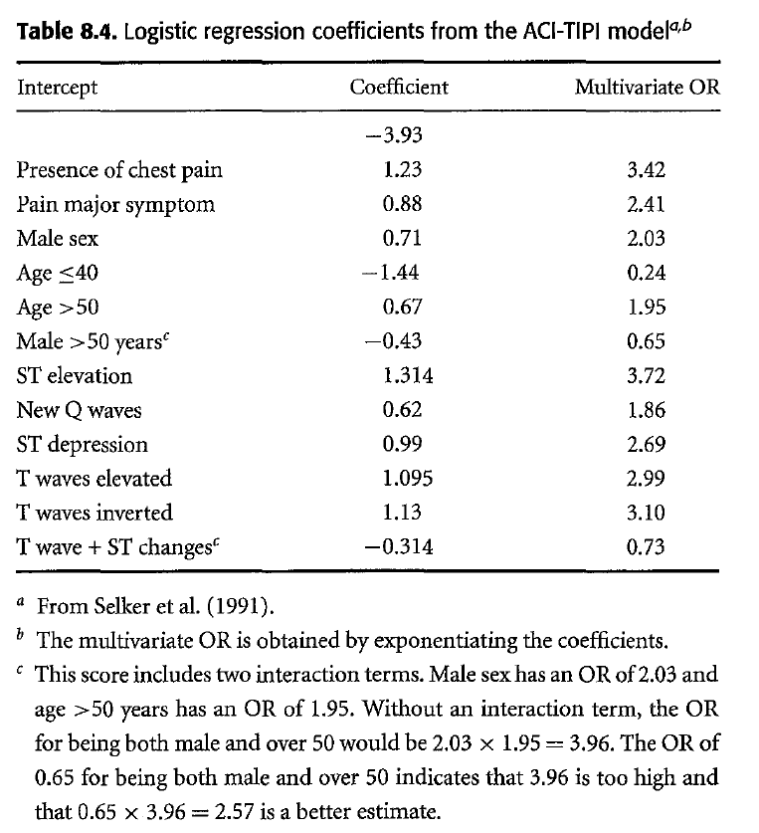
ACI-TIPI Clinical Decision Rule
Newman & Kohn, EBD, 1st Edition

Slide 18
Model Performance
Discrimination - how well the test differentiates between patients more and less likely to have the outcome
Calibration - how well the probability estimated from the test result matches the actual probability
  Low and high predictions correct?

Slide 19
Model Performance Measures: Discrimination
Most common multivariable techniques
  Logistic regression – dichotomous outcome
    AUROC (c-statistic)
  Cox regression – time to event data
    Outcomes of censored patients unknown, constructing ROC impossible
    Concordance statistic (c-statistic can be easily calculated) – same interpretation as AUROC
  Linear regression – continuous outcomes
    Squared multiple correlation coefficient (R²), aka the explained variance

Slide 20
AUROC Curve
Also known as a relative operating characteristic curve
The ROC curve illustrates sensitivity and specificity tradeoffs as we vary the cutoff point
  A plot of the FP probability on the x-axis and the TP probability on the y-axis across several thresholds of a continuous value
Each point on the curve represents a Se/Sp pair corresponding to a particular cut-off (decision threshold or criterion value)
AUC is the area between the curve and the X-axis

Slide 21
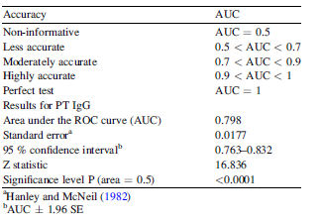
Area Under the ROC Curve (AUC)
  Quantifies the discrimination of the test
    the probability that, confronted with a pair of randomly chosen patients, one of whom truly has the disease of interest and the other of whom truly does not, the test will accurately identify which of the pair has the disease.
    The AUC summarizes the whole of the ROC curve, and therefore all parts of the curve are represented within the AUC.
http://osctr.ouhsc.edu/Seminar%20Series

Slide 22
Model Performance Measures: Discrimination
Binary Outcomes
Overall Misclassification (Error) Rate
  the proportion of observations (over the sample) for which the predicted outcome and actual outcome disagree; Error Rate = (FP + FN)/N
    Accuracy Rate = 1 − misclassification rate
False positive and False Negative Rates
    P^(Y=1|X ) + P^(Y=0|X ) = 1 (where P^(= predicted probability and X=covariates)
    SAS default : If P^(Y=1>0.5|X ) then Test = 1 (positive) else test = 0 (negative)
  FP/FN → compare actual classification to test classification

Slide 23
Model Performance Measures: Discrimination
Tjur R-Squared
Also known as Tjur’s D or Tjur’s coefficient of discrimination
Mean difference of the predicted probabilities of the two response levels
  For each of the two categories of the dependent variable, calculate the mean of the predicted probabilities of an event. Then, take the absolute value of the difference between those two means, that’s it!
Closely related to R2 definitions for linear models
Allison, P. D. Commentary (2014). Measures of fit for logistic regression.
In Proceedings of the SAS Global Forum 2014 Conference.

Slide 24
Model Performance Measures: Recalibrating or updating a model
Reclassification Measures: Extent to which an extended model improves the classification of participants with and without the outcome compared with the basic model without that predictor.
Net Reclassification Improvement (NRI)
  Quantifies the number of individuals that are correctly reclassified into clinically meaningful higher or lower risk categories with the addition of a new predictor, using pre-specified risk groups [Pencina et al., 2008].

Slide 25
Model Performance Measures: Reclassification Measures
Integrated Discrimination Improvement (IDI)
  In contrast to the NRI, the IDI does not require subjectively predefined risk thresholds.
  Estimated improvement in the average sensitivity of the basic model with addition of the new predictor minus the estimated decrease in the mean specificity, summarized over all possible risk thresholds.
NRI and IDI – Potentially useful model performance measures
  Newer, statistical methods not yet well developed
  Careful application is necessary

Slide 26
Model Performance Measures: Calibration
Quantifying/Assessing Calibration
  Calibration plot - graph of observed versus predicted probabilities
    Calibration slope -- < 1 (overfitted); > 1 (underfitted)
  Goodness of Fit Tests (e.g. Hosmer and Lemeshow)
  Bland-Altman Calibration Plots with Mean Bias* and SD of Errors
  Brier Score (Mean Squared Error)
Note, overall calibration of a model is generally good in the “derivation” dataset
  E.g. mean bias is always 0 for a logistic regression model in the dataset used to derive its coefficients

Slide 27
Model Performance Measures: Calibration
How accurate are the predicted probabilities?
  Break the population into groups (often deciles of risk)
  Compare actual (observed frequencies) and predicted probabilities for each group
  Goodness-of-Fit statistical tests (e.g. Hosmer-Lemeshow) provide p-values for the discrepancy between observed and predicted probabilities but no summary estimate of "effect size“
    Large sample size - P-values can be statistically significant even when the calibration is good
    Small sample size - poor calibration will not be statistically significant

Slide 28
Calibration Plots
Grant et al., 2018. Statistical Primer: developing and validating a risk prediction model

Slide 29
Model Performance Measures: Calibration
The Brier Score
Mean squared difference between the predicted probability and the actual outcome.
  Ranges from 0 (perfect agreement in prediction) to 1 (perfect disagreement in prediction).
  If the predicted probability is 1 and the outcome occurs, then the Brier Score is 0, the best score achievable.
    predicted probability is 0.8 and it happens, then the Brier Score is (0.8-1)^2 =0.04.
  The lower the Brier score is for a set of predictions, the better the predictions are calibrated.

Slide 30
Internal Validation and Shrinkage of the Prediction Model
Initial prediction model applied to the data from which it is derived tends to be overly optimistic
  Overfitting, regression-to-the-mean bias
  model’s predicted probabilities will be too extreme (too high for the diseased and too low for the non-diseased) when the model is applied to new patients; calibration will be poorer and discrimination lower in daily practice [Altman et al., 2009; Moonset al., 2012b].
Amount of overfitting can be estimated and corrected using internal validation methods
  Split sample and cross-validation – one sample used for development and remainder for estimating accuracy
  Bootstrapping – first model is developed on full sample, then multiple random samples are drawn from the full sample - Average optimism in discrimination and calibration can be used to adjust original model (i.e. shrink the model)
  Heuristic shrinkage factor; penalized estimation methods

Slide 31
Split-sample Validation
Inefficient
Replication instability

Slide 32
K-fold cross-validation
http://qingkaikong.blogspot.com/

Slide 33
Harrell - Bootstrapping Steps
1. Develop the model using all n subjects and whatever stepwise testing is deemed necessary. Let C_{app} denote the apparent C from this model, i.e. computed on the same sample used to derive the fit.
2. Generate a sample of size n with replacement from the original sample (for both predictors and the response).
3. Fit the full or possibly stepwise model, using the same stopping rule as was used to derive C_{app}.
4. Compute the apparent C for this model on the bootstrap sample with replacement. Call it C_{boot}.
5. ‘Freeze’ this reduced model, and evaluate its performance on the original dataset. Let C_{orig} denote the C.
6. The optimism in the fit from the bootstrap sample is C_{boot} – C_{orig}.
7. Repeat steps 2 to 6 100-200 times.
8. Average the optimism estimates to arrive at O.
9. The bootstrap corrected performance of the original stepwise model is C_{app} – O.

Slide 34
Harrell - Bootstrapping Steps

Slide 35
Internal Validation
In general, shrinkage of regression coefficients may improve the performance of a prognostic model substantially.
When the sample size is large, no shrinkage will be required, in contrast to a small data set, where a substantial shrinkage may be needed ( Steyerberg & Harrell,2000).
  If the number of predictors over the number of observations is less than 1/10, shrinkage is necessary, if this ratio is between 1/10 and 1/20, shrinkage is advisable, and if the ratio is smaller than 1/20, shrinkage is not necessary.
Internal validation techniques only address pure sampling variability and not changes in patient population
  Not a substitute for external validation

Slide 36
Penalized Regression
Flexible shrinkage approach that is effective when the EPV is low (<10)
Aims to fit the same statistical model as standard regression but uses a different estimation procedure
Few events - the range of the predicted risks is too wide
  can be reduced by shrinking the regression coefficients towards zero
Penalized regression places a constraint on the values of the regression coefficients
  Ridge, lasso

Slide 37
Penalized Regression
Pavlou et al., BMJ ﻿ 2015;351:h3868

Slide 38
Bias in Prognostic Research
Confounding is not an issue in prediction research
Loss to follow-up (Prognostic)
  Bias due to indeterminates, missing data
    Multiple imputation
    Worst-case sensitivity analysis
Ascertainment (Incorporation) bias[Diagnostic/Prognostic]
  Diagnostic Review bias
    Test/predictor that is being evaluated is included in the reference standard
  Test Review Bias

Slide 39
Biases
Biases
  Verification Bias (Diagnostic)
    When the decision to perform the reference standard depends on the result of the index test (partial verification)
    When the type of reference standard used depends on the result of the index test (differential verification)
  Spectrum Bias (Diagnostic/Prognostic)
    Subjects of dx test study do not have a reasonable spectrum of the condition being tested for and of the ‘non-disease’ that may mimic it
    Study population not representative of target population
  Overfitting Bias (Diagnostic/Prognostic)
    ‘If you torture data sufficiently, it will confess to almost anything’ – Fred Menger (Newman, EBD)
    Mainly a problem when a combination of tests is chosen from many candidate tests to identify a disease or predict a prognosis

Slide 40
External Validation
Aims to address the accuracy of a model in patients from a different but plausibly related population, representing the underlying disease domain.
    Temporal validation
    Geographical validation
    Domain/Setting validation
Internal validation alone is limited in determining the generalizability of a prediction model

Slide 41
External Validation:
Comparisons Between Derivation and Validation Data
Study Population and Variables
  Patient characteristics and overall outcome rates
  Outcome definition and ascertainment
    Selection of diseased and non-diseased → otherwise spectrum bias
    Outcome ascertainment independent of outcome → otherwise diagnostic review bias
  Predictor ascertainment
    Independent of outcome → otherwise incorporation bias
Model performance
  Calibration – Hosmer-Lemeshow GOF test; Calibration plot (observed vs predicted); Calibration slope; Brier Score
  Discrimination – AUC (C-statistic); also Tjur R-squared, Error Rate

Slide 42
Presenting the Prediction Model
Original untransformed model
  calculator or computerized patient record
Nomogram
Decision tree - Classification and Regression Trees (CART)
  creates a rule such as 'If a patient has finding a, b, or c, they have an XX probability of disease Y'

Slide 43
Presenting the Prediction Model
Simplified risk score (SRS)
  Commonly done using the Framingham Methodology (Sullivan et al., 2004)
    divide each regression coefficient by the smallest regression coefficient
  Must be accompanied by the observed disease frequencies across score categories
  Some loss in dx accuracy, but minimal and easy to use
  Grobbee & Hoes recommend reporting both the untransformed model and SRS with AUROCs

Slide 44
Use of Points System vs Multivariable Models
For most risk profiles, there is very good agreement (ICC > 0.9)between the estimates (predicted probabilities) produced by the points system and those produced by the MV models.
  Divergences occur primarily at the extremes
  Loss of information is slightly more pronounced when the risk factors are modelled as continuous
Sullivan et al., 2004

Slide 45
Model Impact
Impact of the risk prediction model on clinical practice.
Gold-standard design
  Randomized, controlled clinical trial comparing patient outcome between randomized groups
Study Sample
Prediction model
Care/decisions guided by prediction model
No prediction model
Usual care/Decisions
Measure health outcome
Measure health outcome
Randomize

Slide 46
Model Impact
Net benefit decision curve analysis
Grant et al., 2018. Statistical Primer: developing and validating a risk prediction model
Vickers, A. J., van Calster, B., & Steyerberg, E. W. (2019). A simple, step-by-step guide to interpreting decision curve analysis. Diagnostic and prognostic research, 3, 18.

Slide 47
Reporting: The TRIPOD Statement

Slide 48
The TRIPOD Statement

Slide 49
Applicability of Prediction Models
Prediction models often too complex for daily use in clinical settings
Diagnostic/prognostic models not routinely validated
Tests/factors included in the final model – inclusion of advanced tests may lead to a limited applicability
Clinicians may find it difficult to include explicit predicted probabilities in their decision making

Slide 50
Applied Example

Slide 51
Applied Example: The Trauma Embolic Scoring System

Slide 52
Applied Example: External Validation
Rogers et al., J Trauma Acute Care Surg, Vol 73, Num 2

Slide 53
Acknowledgements
David Thompson, PhD, Emeritus Associate Professor of Biostatistics

